Slide 1
EETS 8332 Advanced Network Design
Dr. Scott Kingsley

Slide 2
Intermediate System-Intermediate System (IS – IS)
History
IS- IS stands for Intermediate System to Intermediate System
IS-IS is the routing protocol for the ISO’s Connectionless Network Protocol (CNLP). It is described in ISO 10589.
Unlike OSPF, which was developed and standardized by the Internet Engineering Task Force (IETF), IS-IS is an ANSI ISO protocol and was originally based on the Digital Equipment Corporation DECNET Phase V Network Technology.
To support the predicted transition from TCP/IP to OSI, an extension to IS-IS, known as Integrated IS-IS was proposed in RFC 1195
The purpose of Integrated IS-IS, also known as Dual IS-IS, was to provide a single routing protocol with the capabilities of routing both CLNP and IP.
Predominantly used in ISP environment.

Slide 3
Intermediate System-Intermediate System (IS – IS)
Introduction
IS-IS is a Link state routing protocol and uses the SPF algorithm for computing best path just like OSPF.
IS-IS is an IGP used for routing within a single administrative domain.
It may be used as an IGP to support IP as well as OSI. This allows a single routing protocol to be used to support pure IP environments, pure OSI environments, and dual environments.
Less widely implemented on router platforms
Runs on data link layer, OSPF runs on IP layer
Predominantly used in ISP environment.

Slide 4
Intermediate System-Intermediate System (IS – IS)
ISIS uses Networking Service Access Point( NSAP) addressing scheme avoids dependencies on IP as with OSPF
Suits ISPs with “stringy” networks, diverse infrastructure, etc, not fitting central core model of OSPF. More flexible than OSPF, but easier to make mistakes too
Supports a 2-level hierarchy : level-1 (areas) and level-2 (backbone)
IS-IS routes have an administrative distance of 115
IS-IS uses an arbitrary cost for its metric. IS-IS additionally has three optional metrics: delay, expense, and error
IS-IS has no hop-count limit.

Slide 5
Intermediate System-Intermediate System (IS – IS)
There are two main methods that are available for routing protocols to support dual OSI and IP routers.
One method, known as "Ships in the Night", makes use of completely independent routing protocols for each of the two protocol suites. An alternate approach is more prevalent which makes use of a single integrated protocol for interior routing (i.e., for calculating routes within a routing domain) for both protocol suites.
This integrated protocol design is based on the OSI Intra-domain IS- IS routing protocol with IP-specific functions added.
By supporting both IP and OSI traffic, this integrated protocol design supports traffic to IP hosts, OSI end systems, and dual end systems.
This approach is "integrated" in the sense that the IS-IS protocol can be used to support pure-IP environments, pure-OSI environments, and dual environments. In addition, this approach allows interconnection of dual (IP and OSI) routing domains with other dual domains, with IP-only domains, and with OSI-only domains.

Slide 6
Intermediate System-Intermediate System (IS – IS)
This approach does not change the way that IP or OSI packets are handled.
It makes use of the existing IS-IS packets, with IP- specific fields added.

Slide 7
Intermediate System-Intermediate System (IS – IS)
IS-IS versus OSPF
The ISO ( IS-IS) often uses different terms than the IETF (OSPF) to describe the same entities.

Slide 8
Intermediate System-Intermediate System (IS – IS)
IS-IS OSPF
End System (ES) Host
Intermediate System (IS) Router
Circuit Link
Packet Data Unit ( PDU) Packet
Designated IS (DIS) Designated Router (DR)
NO BDIS BDR
Link-state PDU (LSP) Link-state Advertisement (LSA)
IIH PDU Hello Packet
Complete sequence number PDU (CSNP) Database Description (DBD)

Slide 9
Intermediate System-Intermediate System (IS – IS)
IS-IS OSPF
Sub-Domain Area Area
Level-1 Area Non-backbone Area
Level-2 Sub-Domain Area Backbone Area
L1/L2 Router ABR
Any IS ASBR

Slide 10
Intermediate System-Intermediate System (IS – IS)
IS-IS/OSPF similarities
Both are link-state routing protocols.
Both are using the SPF algorithm to calculate the best paths.
Both are classless routing protocols.
Both build adjacencies with their direct connected neighbors.
Both support the concept of areas to allow hierarchical network topology.
Both elect a DR on for broadcast multi-access networks.
Both routers support authentication.
Cisco routers allow multiple instances per device of both protocols.

Slide 11
Intermediate System-Intermediate System (IS – IS)
IS-IS/OSPF differences
IS-IS router can only belong to one area while an OSPF router can belong to multiple areas.
IS-IS uses CLNS to send information between routers while OSPF is a pure IP routing protocol.
IS-IS backbone is the contiguous Level 2 routers; OSPF uses the concept of Area 0 for this purpose.
IS-IS all routers form adjacencies with the DIS and each other while for OSPF the routers form adjacencies with the DR only.

Slide 12
Intermediate System-Intermediate System (IS – IS)
IS-IS hierarchy
Supports 2 Level hierarchy
Level-2 (The backbone)
Level-1 (The areas)
A Router can be
Level-1 (L1 ) Router
Level-2 (L2) Router
Level-1/2( L1/L2) Router

Slide 13
Intermediate System-Intermediate System (IS – IS)
Level-1 Router
Form neighbors only on the same area.
Maintain only Level-1 link-state database with all routing information for the Area.
Every L1 router within an Area maintains an identical link-state database.
Level-2 Router
Form neighbors in the same or other areas,
Maintain only Level-2 link-state database with all routing information for the Inter-
Area routing.
Level-3 Router
Form neighbors on any Area.
Must maintain two separate link-state database: level-1 LSDB & level -2 LSDB

Slide 14
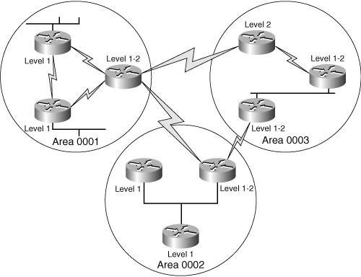
Intermediate System-Intermediate System (IS – IS)
IS-IS are design
Each IS-IS router belongs to exactly one Area.
IS-IS is more flexible when extending the backbone.

Slide 15
Intermediate System-Intermediate System (IS – IS)
IS-IS Areas
IS-IS use areas to create a two-level hierarchical topology like OSPF, difference exists in the way in which the two protocols define their areas
OSPF area borders fall within routers and the routers that connect the area are ABRs, while IS-IS areas fall on links and the routers that connect the areas are level 2 routers.
ISIS does not have a backbone area as such like OSPF. Instead the backbone is the contiguous collection of Level-2 capable routers.
Routers that have no direct connectivity to another area are called Level 1 routers.
L1 routers are analogous to OSPF non-backbone internal routers and L2 routers are analogous to OSPF backbone routers, and L1/L2 routers are analogous to OSPF ABRs.

Slide 16
Intermediate System-Intermediate System (IS – IS)
L1/L2 routers must maintain both a level 1 link state database and a level 2 link state database.
L1/L2 routers do not advertise L2 routes to L1 routers, so L1 routers have no knowledge of destinations outside of its own area.
L1/L2 routers maintaining separate level 1 and level 2 link state databases will calculate separate SPF trees for the level 1 and level 2 topology.
Each router is identified with Network Entity Title (NET).

Slide 17
IS-IS PDU Format – LAN Hello PDU, Point-to-Point Hello PDU, LSP, CSNP, and PSNP
L1-only
L2-only
L1-L2
L1-only
L1-L2
L1-L2
L1-L2
This router has to behave as level-2 as well in order to guarantee backbone continuity
L1-only
L1-L2
L1-only

Slide 18
Level-1 routing
L1-only routers know only topology of their own area (including all ISs and ESs in the area)
Traffic to other areas is sent via the closest L2 IS
L1L2 ISs set the “attached-bit” in their L1 LSP

Slide 19
Level-2 Routing
L2 routers know about other areas
L2 area addresses and L2 routers
When doing OSI routing, the L2 ISs must know their own area. Therefore never use L2-only on OSI routers
L2-only is possible when doing just IP

Slide 20
Level-2 Routing
Transit traffic requires routers inside the area to know about other areas
routers in transit paths must be L1L2 routers to have the full L2 LSDB
similar to pervasive BGP requirement
L2 routers must be contiguous

Slide 21
Intermediate System-Intermediate System (IS – IS)
As an IS-IS router resides completely within a single area, the Area ID (or area address) is associated with the entire router rather than an interface.
A unique feature of IS-IS is that a router can have up to three area addresses, which can be useful during area transitions.
Each IS-IS router must also have a way to uniquely identify itself within the routing domain. This identification is the function of the System ID, which is analogous to the OSPF Router ID.
Both the Area ID and the System ID are defined on an IS-IS router by a single address, the Network Entity Title (NET).

Slide 22
Intermediate System-Intermediate System (IS – IS)
Neighbors and adjacencies
IS-IS routers discover neighbors and form adjacencies by exchanging IS-IS Hello PDUs.
Hellos are transmitted every 10 seconds, and on Cisco routers this interval can be changed on a per interface basis with the command isis hello-interval.
An IS-IS router uses its Hello PDUs to identify itself and its capabilities and to describe the parameters of the interface on which the Hellos are sent.
If two neighbors are in agreement about their respective capabilities and interface parameters, they become adjacent.
IS-IS is, however, less strict than OSPF in accepting adjacencies

Slide 23
Intermediate System-Intermediate System (IS – IS)
Designated routers
IS-IS elects a Designated Router (or more officially, a Designated IS) on broadcast multi-access networks for the same reason OSPF does.
Unlike OSPF, however, an IS-IS router attached to a broadcast multi-access network establishes adjacencies with all of its neighbors on the network, not just the DR.
Each router multicasts its LSPs to all of its neighbors, and the DR uses a system of PDUs called Sequence Number PDUs (SNPs) to ensure that the flooding of LSPs is reliable.

Slide 24
Intermediate System-Intermediate System (IS – IS)
The IS-IS Designated Router election process is quite simple. Every IS-IS router interface is assigned both an L1 priority and an L2 priority in the range of 0 to 127. Cisco router interfaces have a default priority of 64 for both levels, and this value can be changed with the command isis priority.

Slide 25
Intermediate System-Intermediate System (IS – IS)
The IS-IS Designated Router election process is quite simple. Every IS-IS router interface is assigned both an L1 priority and an L2 priority in the range of 0 to 127. Cisco router interfaces have a default priority of 64 for both levels, and this value can be changed with the command isis priority.
The router advertises its priority in the Hellos sent from each interface—the L1 priority is advertised in L1 Hellos, and the L2 priority is advertised in L2 Hellos.
If the priority is 0, the router is ineligible to become the DR. Interfaces to non- broadcast networks, on which a DR is not elected, also have a priority of 0.

Slide 26
Intermediate System-Intermediate System (IS – IS)
Subnetwork Independent Function
The functions of the subnetwork-independent sublayer define how CLNS delivers packets throughout the CLNP network and how these services are offered to the transport layer.
The routing function itself is divided into four processes: the Update, Decision, Forwarding and Receive processes.
As the names of the last two processes suggest, the Forwarding process is responsible for transmitting PDUs, and the Receive process is responsible for the reception of PDUs

Slide 27
Intermediate System-Intermediate System (IS – IS)
Update process
The Update process is responsible for constructing the L1 and L2 link-state databases.
To do so, L1 LSPs are flooded throughout the area in which they are originated, and L2 LSPs are flooded over all L2 adjacencies.

Slide 28
Intermediate System-Intermediate System (IS – IS)
Decision process
Once the Update process has built the link-state database, the Decision process uses the information in the database to calculate a shortest-path tree.
The process then uses the shortest-path tree to construct a forwarding database (route table). Separate SPF calculations are run for the L1 database and the L2 database.
ISO 10589 specifies the following metrics (one required and three optional) to be used by IS-IS to calculate the shortest path:

Slide 29
Intermediate System-Intermediate System (IS – IS)
Default This metric must be supported and understood by every IS-IS router.
Delay This optional metric reflects the transit delay of a subnetwork.
Expense This optional metric reflects the monetary cost of using the subnetwork.
Error This optional metric reflects the residual error probability of the subnetwork, similar to the IGRP/EIGRP reliability metric.

Slide 30
Intermediate System-Intermediate System (IS – IS)
Each metric is expressed as an integer between 0 and 63, and a separate route is calculated for each metric.
Therefore, if a system supports all four metrics, the SPF calculation must be run four times for both L1 routes and L2 routes.
Because of the potential for many iterations of the SPF calculation for every destination, resulting in many different route tables, and because the optional metrics provide rudimentary Type of Service routing at best,

Slide 31
Intermediate System-Intermediate System (IS – IS)
Cisco supports only the default metric. Cisco assigns a default metric of 10 to every interface, regardless of the interface type.
The command isis metric changes the value of the default metric, and the default can be changed separately for level 1 and level 2.
If the metrics are left at 10 for every interface, every subnetwork is considered equal and the IS-IS metric becomes a simple measure of hop count, where each hop has a cost of 10.

Slide 32
Intermediate System-Intermediate System (IS – IS)
IS-IS protocols
IS-IS consists of three sub-protocols that work in tandem to achieve end-to-end routing which ISO defined as Connectionless Network Service (CLNS)
CLNP (Connectionless Network Protocol) – serves as the Layer-3 protocol for IS-IS
ES-IS (End System -to- Intermediate System) – used to route between hosts and routers
IS-IS (Intermediate System -to- Intermediate System) – used to route between routers.

Slide 33
Intermediate System-Intermediate System (IS – IS)
IS-IS was originally developed to route ISO CLNP addresses . However, CLNP addressing never became prominently used.
Thus, IS-IS was modified to additionally support IP routing, and became Integrated (or Dual) IS-IS

Slide 34
Intermediate System-Intermediate System (IS – IS)
IS-IS defines four types of packet:
Hello
LSP
CSNP
PSNP

Slide 35
Intermediate System-Intermediate System (IS – IS)
LSP (Link State Packet) : used to share topology information between routers. There are separate LSPs for Level 1 and Level 2 routing.
CSNP (Complete Sequence Number PDU) : An update containing the full link-state database. IS-IS routers will refresh the full database every 15 minutes.
PSNP (Partial Sequence Number PDU) : Used by IS-IS routers to both request and acknowledge a link-state update.

Slide 36
IS-IS Protocols and Addressing: CLNS
IS-IS consists of three sub-protocols that work in tandem to achieve end-to-end routing which ISO defined as Connectionless Network Service (CLNS):
CLNP (Connectionless Network Protocol) – serves as the Layer-3 protocol for IS-IS (and was developed by ISO).
ES-IS (End System -to- Intermediate System) – used to route between hosts and routers.
IS-IS (Intermediate System -to- Intermediate System) – used to route between routers.

Slide 37
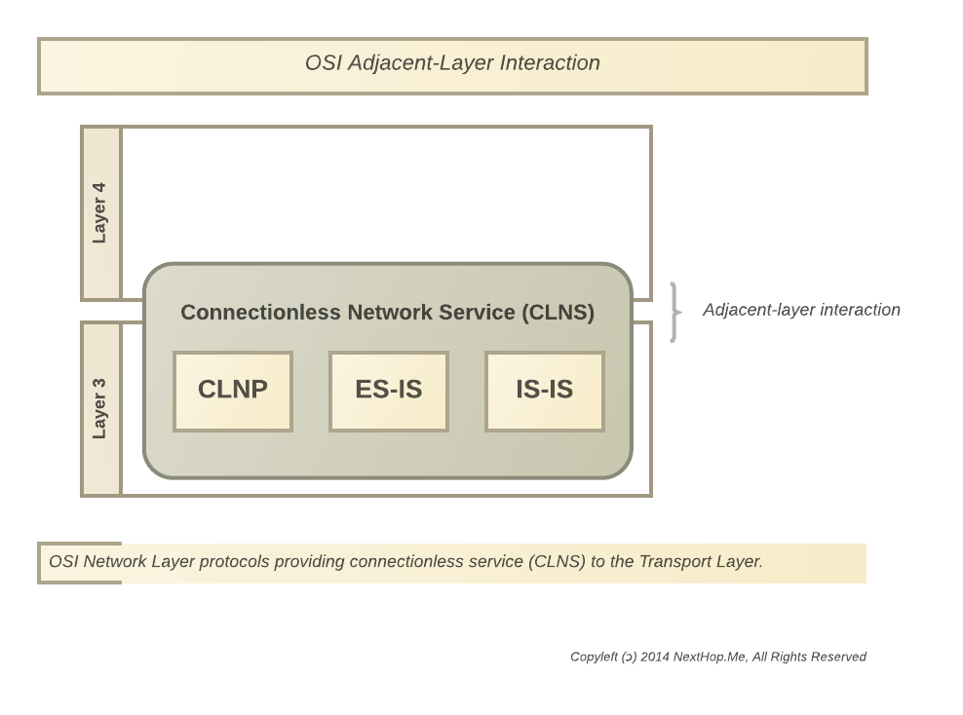
OSI Protocols

Slide 38
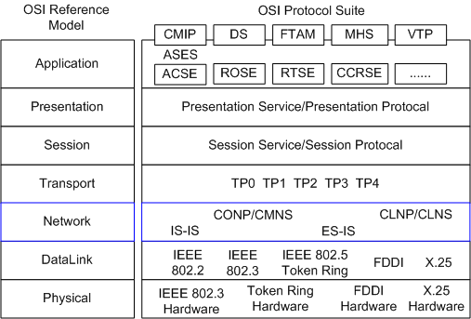
OSI Protocols

Slide 39
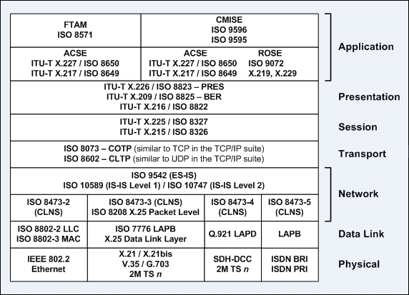
OSI Protocols

Slide 40
IS-IS Protocols and Addressing CLNP
IS-IS was originally developed to route ISO CLNP addresses (outlined in RFC 1142).
However, CLNP addressing never became prominently used.
Thus, IS-IS was modified to additionally support IP routing, and became Integrated (or Dual) IS-IS (outlined in RFC 1195).

Slide 41
IS-IS Protocols and Addressing: CLNP
The IS-IS CLNP address is hexadecimal and of variable length, and can range from 64 to 160 bits in length.

Slide 42
IS-IS Protocols and Addressing: CLNP
Because it was developed as part of the OSI network protocols and not part of TCP/IP, IS-IS doesn’t use IP addresses. I
S-IS addresses are called NETs, or network entity titles.
While IP addresses are 32 bits long and are normally written in dotted quad notation (such as 192.168.1.2), NETs can be 8 to 20 bytes long, but are generally 10 bytes long and are written as shown in this example:
49.0001.1921.6800.1002.00

Slide 43
IS-IS Protocols and Addressing: CLNP
The IS-IS address consists of three parts:
Area identifier: The first three bytes are the area ID. The first byte of this example — 49 — is the address family identifier (AFI) of the authority, which is equivalent to the IP address space that is assigned to an autonomous system.
The AFI value 49 is what IS-IS uses for private addressing, which is the equivalent of RFC 1918 address space for IP protocols.
49.0001.1921.6800.1002.00

Slide 44
IS-IS Protocols and Addressing: CLNP
The second two bytes of the area ID — 0001 — represent the IS-IS area number. In this example, the area number is 1.
49.0001.1921.6800.1002.00

Slide 45
IS-IS Protocols and Addressing: CLNP
System identifier: The next six bytes identify the node (that is, the router) on the network. The system identifier is equivalent to the host or address portion on an IP address.
Although you can choose any value for the system identifier, a commonly used method is to use binary-coded decimal (BCD) which involves taking the router’s IP address (the address you assigned to the lo0 loopback interface), filling in all leading zeros, and then repositioning the decimal points to form three two-byte numbers.
In this example, if you pad the IP address 192.168.1.2 with zeros, the result is 192.168.001.002. Rearranging the decimal points gives you 1921.6800.1002.
49.0001.1921.6800.1002.00

Slide 46
IS-IS Protocols and Addressing: CLNP
Another common way to assign the system identifier is to start with the router’s media access control (MAC) address, which is a six-byte address and rearrange the decimal points to create three two-byte numbers.
So, for example, for a router MAC address of 00:1B:63:31:86:BE, the IS-IS system identifier is 001b.6331.86be.
49.0001.001b.6331.86be.00

Slide 47
IS-IS Protocols and Addressing: CLNP
NET selector: The final two bytes are the NET selector (NSEL). For IS-IS, they must always be 00, to indicate “this system.”
49.0001.1921.6800.1002.00

Slide 48
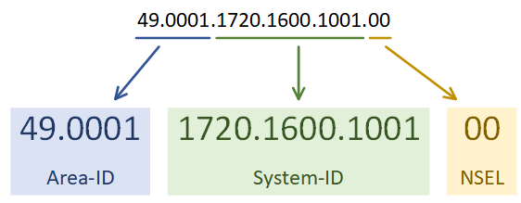
IS-IS Protocols and Addressing

Slide 49
IS-IS Protocols and Addressing: CLNS Address Example
The System-ID is usually populated by the device’s MAC address or IP v4 address.
Recall that CLNS addresses are of variable length. We can specify addresses without an IDI field:
47.0001.1111.2222.3333.00
Thus, the above address contains an AFI (Autonomous System), HO-DSP (Area), System-ID (in this example, a MAC Address), and the NSEL (SEL). Because the SEL field has a zero value (0x00), the above address is defined as a NET address, and not an NSAP address.

Slide 50
IS-IS Protocols and Addressing: CLNS Address Example
ISO CLNS addresses are not applied on an interface-by-interface basis. Instead, a single CLNS address is applied to the entire device.
Even if Integrated IS-IS is being used (thus indicating that IPv4 is being routed instead of CLNS), a CLNS address is still required on the IS-IS router. This is configured under the IS-IS router process.
Routers within the same area must share identical AFI, IDI, and HO-DSP values, but each must have a unique System-ID

Slide 51
IS-IS Protocols and Addressing: CLNS Address Example
The System-ID is usually populated by the device’s MAC address or IP v4 address.
Recall that CLNS addresses are of variable length. We can specify addresses without an IDI field:
47.0001.1111.2222.3333.00
Thus, the above address contains an AFI (Autonomous System), HO-DSP (Area), System-ID (in this example, a MAC Address), and the NSEL (SEL). Because the SEL field has a zero value (0x00), the above address is defined as a NET address, and not an NSAP address.
ISO CLNS addresses are not applied on an interface-by-interface basis. Instead, a single CLNS address is applied to the entire device.

Slide 52
IS-IS Protocols and Addressing: CLNS Address Example
Even if Integrated IS-IS is being used (thus indicating that IPv4 is being routed instead of CLNS), a CLNS address is still required on the IS-IS router. This is configured under the IS-IS router process.
Routers within the same area must share identical AFI, IDI, and HO-DSP values, but each must have a unique System-ID

Slide 53
IS-IS Packet Types
IS-IS defines two categories of network devices:
ES (End System) – identifies an end host.
IS (Intermediate System) – identifies a Layer 3 router.
IS-IS additionally defines four categories of packet types:
Hello
LSP
CSNP
PSNP

Slide 54
IS-IS Packet Types
Hello packets are exchanged for neighbor discovery. Three types of IS-IS Hello packets exist:
IIH (IS-IS Hello) – exchanged between routers (or IS’s) to form neighbor adjacencies.
ESH (ES Hello) – sent from an ES to discover a router.
ISH (IS Hello) – sent from an IS to announce its presence to ES’s

Slide 55
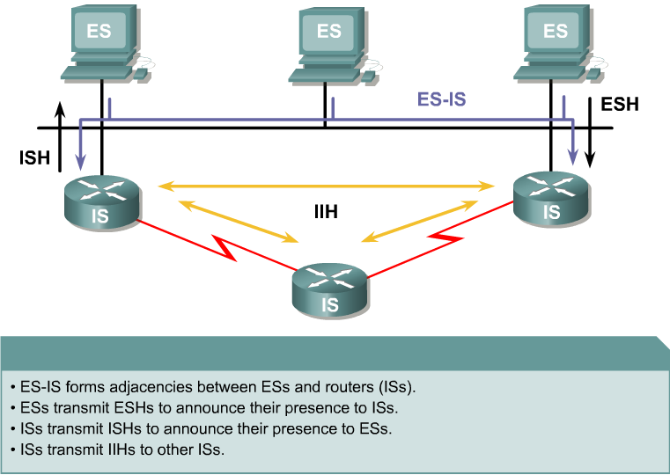
IS-IS Protocols and Addressing

Slide 56
IS-IS Packet Types
An LSP (Link State Packet) is used to share topology information between routers. There are separate LSPs for Level 1 and Level 2 routing. LSP’s are covered in great detail shortly.
A CSNP (Complete Sequence Number PDU) is an update containing the full link-state database. IS-IS routers will refresh the full database every 15 minutes.
A PSNP (Partial Sequence Number PDU) is used by IS-IS routers to both request and acknowledge a link-state update.

Slide 57
IS-IS Packet Types
Neighbors build their topology tables by sharing LSP’s (Link-State Packets), which are roughly the equivalent of OSPF LSA’s.
Depending on the type of adjacency, a router will send out either a Level-1 or Level-2 LSP.

Slide 58
IS-IS
IS-IS only
IS-IS and IP separately (separate route tables)
IS-IS and IP concurrently (single route tables)

Slide 59
Overview of IP-Specific Info for IS-IS
There are six new fields defined for the Integrated IS-IS:
Protocols Supported
IP Interface Address
Authentication Information
IP Internal Reachability Information
IP External Reachability Information
Inter-Domain Routing Protocol Information

Slide 60
Overview of IP-Specific Info for IS-IS
.
The "Protocols Supported" field identifies the protocols which are supported by each router.
The "IP Interface Address" is included in all IS-IS Hello packets and LSPs transmitted by IP-only and dual routers. In the Hello packets, this field occurs once only, and contains the IP address(es) of the interface on which the Hello packet is transmitted (up to a maximum of 63 IP addresses on each interface).
The "Authentication Information" field is optional in all IS-IS PDUs. If used, it contains information used to authenticate the packet.

Slide 61
Overview of IP-Specific Info for IS-IS
.
The "IP Internal Reachability Information" field may be present in all LSPs transmitted by IP-capable routers.
It identifies a list of zero or more [IP address, subnet mask, metrics] reachable by the router which originates the LSP. Each entry must contain a default metric, and may contain delay, expense, and error metrics.
In level 1 LSPs, this field includes only entries directly reachable by the router which originates the LSP, via one of its interfaces.
In level 2 LSPs, this field includes only entries reachable by the router which originates the LSP, either via one of its interfaces, or indirectly via level 1 routing.

Slide 62
Overview of IP-Specific Info for IS-IS
.
The "IP External Reachability Information" field may be present in level 2 LSPs transmitted by level 2 IP-capable routers.
If present, it identifies a list of zero or more [IP address, subnet mask, metrics] entries reachable by the router which originates the level 2 LSP.
Each entry must contain a default metric, and may contain delay, expense, and error metrics. Each entry may contain metrics of type "internal", or of type "external". If a level 2 router does not have

Slide 63
Overview of IP-Specific Info for IS-IS
.
The "Inter-Domain Routing Protocol Information" field may be present in level 2 LSPs transmitted by level 2 IP-capable routers.
This field is transmitted for the convenience of the external routing protocol, and is not used by the IS-IS.
For example, this may be used to allow border routers to find each other. This field may occur multiple times in a level 2 LSP, and may occur in an LSP with any LSP number.

Slide 64
Overview of IP-Specific Info for IS-IS
.
Type Length Values (TLV’s)
All IP-specific information is encoded in IS-IS packets as variable length fields. All variable length fields in IS-IS are encoded as follows:

Slide 65
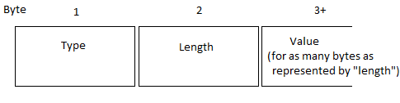
Encoding of IP-Specific Fields in IS-IS PDUs
.
Type Length Values (TLV’s)
All IP-specific information is encoded in IS-IS packets as variable length fields. All variable length fields in IS-IS are encoded as follows:
TLV’s for IP address and IP route tables propagated using TLV’s 129 and 132.

Slide 66
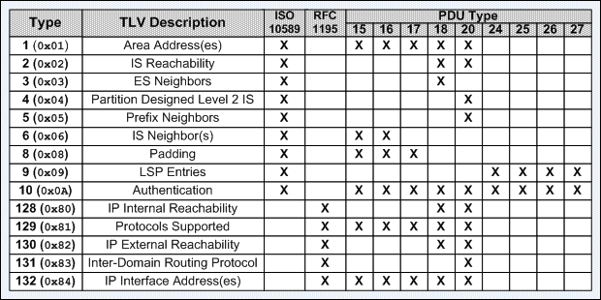
Basic and Common IS-IS TLVs

Slide 67
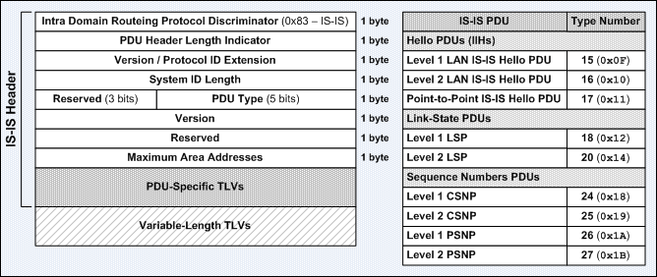
IS-IS PDU Format and IS-IS PDU Type Numbers

Slide 68
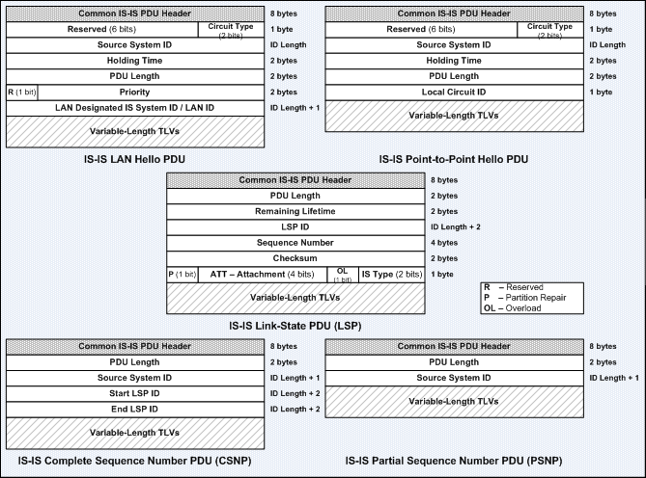
IS-IS PDU Format – LAN Hello PDU, Point-to-Point Hello PDU, LSP, CSNP, and PSNP

Slide 69
Intermediate System-Intermediate System (IS – IS)
IS-IS cheat sheet
http://packetlife.net/media/library/9/IS-IS.pdf

Slide 70
Intermediate System-Intermediate System (IS – IS)
https://www.youtube.com/watch?v=I6OX6f6yMCs&t=21s
https://www.youtube.com/watch?v=o1k1TlxL5Dk
https://www.youtube.com/watch?v=tUf5q28Q1lM

